Slide 1
Introduction to Web Programming
Lecture 3: Introduction to HTML5: PART (3)
HTML Forms
Natheer Gharaibeh

Slide 2
Outlines of today’s lecture
•
HTML forms
•
Form elements
•
Input element
•
Different types of input elements
•
Select, textarea and button elements

Slide 3
But first … what we addressed last week
•
HTML attributes
•
HTML images, hyperlinks, lists and tables
•
How would you create a table in HTML?

Slide 4

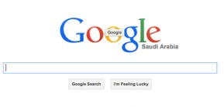

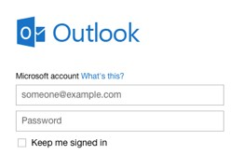

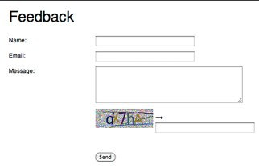
HTML Forms
Forms are used to gather information from users and send it to web servers for processing.
You can build forms that allow users to send feedback about a site, comment on an article, or buy products by submitting credit card information.
To create a form, you can use a variety of input fields, including text fields, check boxes, drop-down menus, and radio buttons.
Forms are an important way to make a site interactive instead of just a collection of static pages with text and images.

Slide 5
How to create a HTML Form
To create a web form, you use the <form> element. This element will contain all your form elements such as fields, buttons..etc
<form>
form elements
</form>
The <form> element requires two attributes, the action attribute and the method attribute

Slide 6
The action attribute
The action attribute defines the action to be performed when the form is submitted such as saving the data to the database or checking a user’s log-in details.
The common way to submit a form to a server is by using a submit button.
Normally, the form is submitted to a web page on a web server.
Example: <form action="action_page.php">

Slide 7
The method attribute
The method attribute specifies the HTTP method (GET or POST) to be used when submitting the forms
If you forget to specify a method attribute on your form, the GET method is used by default
<form or: | action="action_page.php" | method="GET">
<form | action="action_page.php" | method="POST">

Slide 8
The GET method
The GET method sends your form data within a URL
When a user submits the form, the browser will start to create a new URL to send the user to
This method is commonly used when performing tasks that just need to fetch existing data from a web server, such as searches

Slide 9

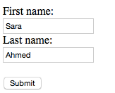
GET method example
•When a user submits the form, the browser will start to create a new URL to send the user to. For the form above the URL will look something like the one below.
•http://www.domainname.com/action_page.php? firstname=Sara&lastname=Ahmed
•Domain, path and parameters.
Have a look at how the URL is constructed when submitting a query to Google search engine!

Slide 10
When to use GET method
If the form submission is passive (e.g. fetching existing data from a web server) like a search engine query, and without sensitive information
GET is best suited to short amounts of data. Size limitations are set in your browser

Slide 11
The POST Method
•The data is not added to the URL as parameters.
Instead, the data is effectively sent in the background and completely hidden from the URL
•The POST method should be used when performing any action that will involve data being updated/saved to a database
•While it is also technically possible to save data using the GET method, it is considered a security best practice to use POST for these actions.

Slide 12
When to use POST method
If the form is saving/updating data, or includes
sensitive information (password).
POST offers better security because the submitted data is not visible in the page address.

Slide 13
<form> Elements
•
Some of the <form> elements:
•
The <input> element
•
The <select> element
•
The <textarea> element
•
The <button> element

Slide 14
The <input> Element
•The main form control element that you will use in your web forms is the <input> element
•It is used for collecting all sorts of data from your users
•You can specify what sort of data you want to collect using the type attribute
•To be submitted correctly, each input field must have a name attribute

Slide 15
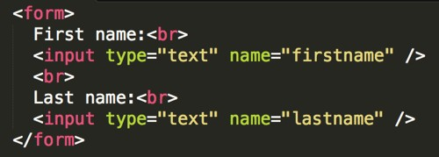

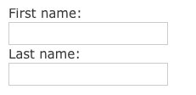
Input type: text
<input type="text"> defines a one-line input field for text input.
Example:
Note: The form itself is not visible. Also note that the default width of a text field is 20 characters.

Slide 16
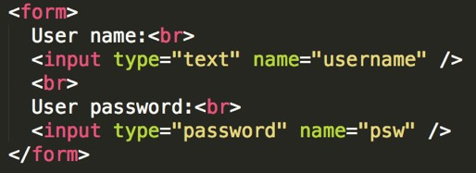

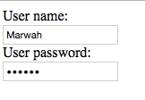
Input type: password
•<input type="password"> defines a password field
•The characters in a password field are masked (shown as asterisks or circles)

Slide 17
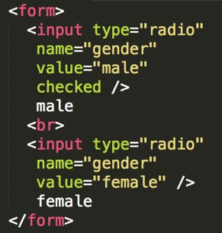


Input type: radio
<input type="radio"> defines a radio button
Radio buttons let a user select ONE of a limited number of choices
All radio buttons in a group have the same name.

Slide 18
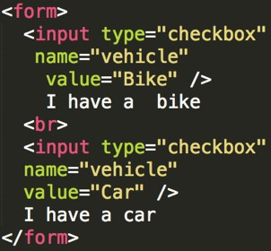


Input type: checkbox
•<input type="checkbox"> defines a checkbox
•Checkboxes let a user select ZERO or MORE options of a limited number of choices.

Slide 19
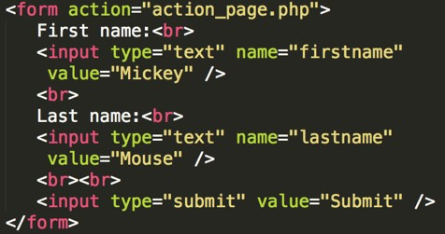

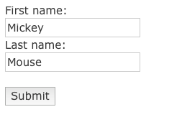
Input type:submit
•<input type="submit"> defines a button for submitting a form to a form-handler
•The form-handler is typically a server page with a script for processing input data
•The form-handler is specified in the form's action attribute
•If you omit the submit button's value attribute, the button will get a default text

Slide 20
Input type: button
<input type="button"> defines a button
<input type="button" onclick="alert('Hello World!')" value="Click Me!” />

Slide 21
HTML5 Input Types
HTML5 added several new input types:
color
date
datetime
datetime-local
email
month
number
range
search
tel
time
url
week
Input types, not supported by old web browsers, will behave as input type text.

Slide 22
Input type:email
The <input type="email"> is used for input fields that should contain an e-mail address
Depending on browser support, the e-mail address can be automatically validated when submitted
Some smartphones recognize the email type, and adds ".com" to the keyboard to match email input
Example:
<form>E-mail:
<input type="email" name=“email” />
</form>

Slide 23
Input type: range
•The <input type="range"> is used for input fields that should contain a value within a range.
•Depending on browser support, the input field can be displayed as a slider control.
Example
<form>
<input type="range" name="points" min="0" max=“10" />
</form>

Slide 24
Input type: time
•The <input type="time"> allows the user to select a time.
•Depending on browser support, a time picker can show up in the input field.
Example
<form>
Select a time:
<input type="time" name=“usr_time" />
</form>

Slide 25
Input type: url
•The <input type="url"> is used for input fields that should contain a URL address
•Depending on browser support, the url field can be automatically validated when submitted
•Some smartphones recognize the url type, and add ".com" to the keyboard to match url input

Slide 26
Read about the rest of HTML5 input types from www.w3schools.com

Slide 27
Other Input Attributes
The value attribute
The value attribute specifies the initial value for an input field
The readonly Attribute
The readonly attribute specifies that the input field is read only (cannot be changed)
The disabled Attribute
The disabled attribute specifies that the input field is disabled.
The size Attribute
The size attribute specifies the size (in characters) for the input field
The maxlength Attribute
The maxlength attribute specifies the maximum allowed length for the input field

Slide 28
HTML5 Input Attributes
HTML5 added the following attributes for <input>:
autocomplete
autofocus
form
formaction
formenctype
formmethod
formnovalidate
formtarget
height and width
list
min and max
multiple
pattern (regexp)
placeholder
required
step

Slide 29
HTML5 Input Attributes (Cont.)
The min and max Attributes
  The min and max attributes specify the minimum and maximum value for an <input> element.
  The min and max attributes work with the following input types: number, range, date, datetime, datetime-local, month, time and week.
The required Attribute
  The required attribute is a boolean attribute.
  When present, it specifies that an input field must be filled out before submitting the form.
  The required attribute works with the following input types: text, search, url, tel, email, password, date pickers, number, checkbox, radio, and file.
The placeholder Attribute
  The placeholder attribute specifies a hint that describes the expected value of an input field (a sample value or a short description of the format).
  The hint is displayed in the input field before the user enters a value.
  The placeholder attribute works with the following input types: text, search, url, tel, email, and password.

Slide 30

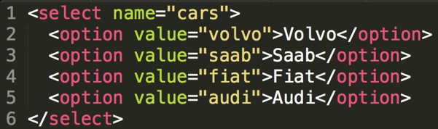

The <select> Element
The <select> element defines a drop-down list
The <option> elements defines the options to select
The list will normally show the first item as selected
You can add a selected attribute to define a predefined option.

Slide 31
Read about the rest of HTML5 input attributes from www.w3schools.com

Slide 32
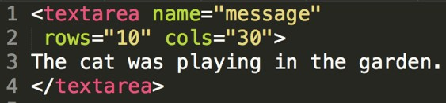

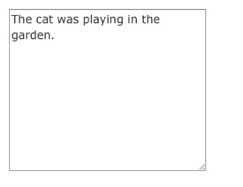
The <textarea> Element
The <textarea> element defines a multi-line input field (a text area)

Slide 33
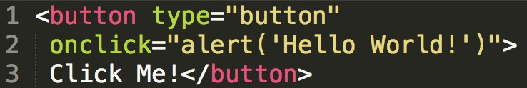


The <button> Element
The <button> element defines a clickable button

Slide 34
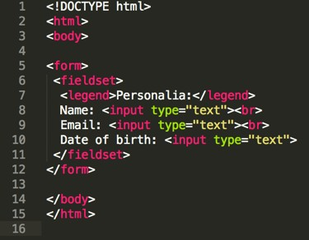

Grouping Form Data
The <fieldset> element groups related data in a form.
The <legend> element defines a caption for the <fieldset> element.

Slide 35

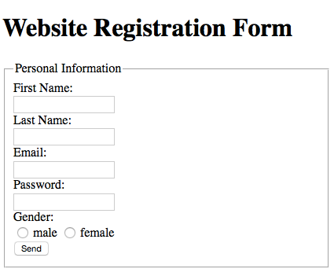
Form Demo

Slide 36
It is your responsibility to read about all input types and attributes under the HTML Forms heading from:
H.W
•
http://www.w3schools.com/html/default.asp.
•
http://diveintohtml5.info/forms.html

Slide 37
References
www.w3schools.com
West, M. (2012). HTML5 foundations. John Wiley & Sons.
Robson, E., & Freeman, E. (2012). Head first HTML and CSS. O'Reilly Media, Inc.
Duckett, J. (2011). HTML and CSS: Design and Build Websites. John Wiley & Sons.
Deitel & Deitel (2011). Internet and World Wide Web How to Program, 5th Edition, Harvey & Paul Deitel & Associates.

